Slide 1
AWS RDS(Relational Database Service)
RDS is not a database, it’s a service that manages database

Slide 2
AWS RDS(Relational Database Service)

Slide 3
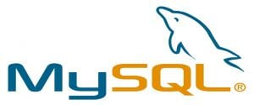
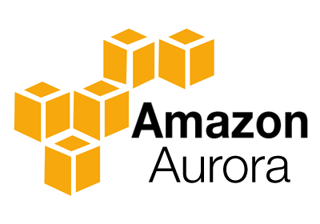
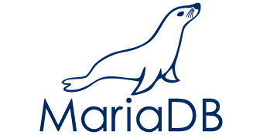

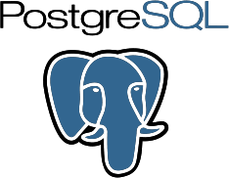

RDS Supports
Notes:
It is a relational database engine made by amazon which combines the speed and reliability of high-end commercial databases with the simplicity and cost-effectiveness of open source databases. Amazon claims that Aurora is 5x faster than RDS MySQL.

Slide 4
RDS AWS Components:
DB Instances
Regions and Availability Zones
Security Groups
DB Parameter Groups
DB Option Groups

Slide 5
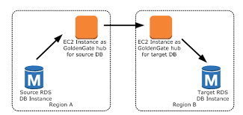
DB Instances
It is an isolated database environment in the cloud, which can contain multiple user-created databases, and can be accessed using the same tools and applications that one uses with a stand-alone database instance.
A DB Instance can be created using the AWS Management Console , the Amazon RDS API, or the AWS Command line Interface .
The computation and memory capacity of a DB Instance depends on the DB Instance class.
For each DB Instance you can select from 5GB to 6TB of associated storage capacity.
The DB Instances are of the following types:
Standard Instances (m4,m3)
Memory Optimised (r3)
Micro Instances (t2)

Slide 6
Regions and Availability Zones
The AWS resources are housed in highly available data centers, which are located in different areas of the world. This “area” is called a region.
Each region has multiple Availability Zones (AZ), they are distinct locations which are engineered to be isolated from the failure of other AZs.
You can deploy your DB Instance in multiple AZ, this ensures a failover i.e. in case one AZ goes down, there is a second to switch over to. The failover instance is called a standby, and the original instance is called the primary instance.

Slide 7
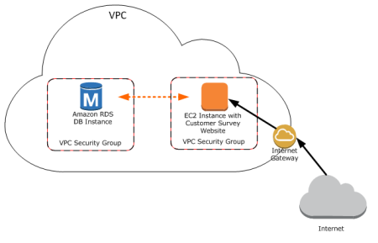
Security Groups
A security group controls the access to a DB Instance. It does so by specifying a range of IP addresses or the EC2 instances that you want to give access.
Amazon RDS uses 3 types of Security Groups:
VPC Security Group
It controls the DB Instance that is inside a VPC.
EC2 Security Group
It controls access to an EC2 Instance and can be used with a DB Instance.
DB Security Group
It controls the DB Instance that is not in a VPC.

Slide 8
DB Parameter groups
It contains the engine configuration values that can be applied to one or more DB Instances of the same instance type.
If you don’t apply a DB Parameter group to your instance, you are assigned a default Parameter group which has the default values

Slide 9
DB Option groups
Some DB engines offer tools that simplify managing your databases.
RDS makes these tools available with the use of Option groups.

Slide 10
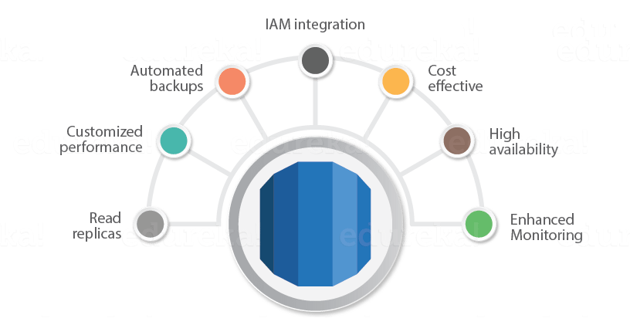
RDS Advantages
Notes:
Let’s talk about some interesting advantages that you get when you are using RDS AWS,
So usually when you talk about database services, the CPU, memory, storage, IOs is bundled together, i.e. you cannot control them individually, but with AWS RDS, each of these parameters can be tweaked individually.
Like we discussed earlier, it manages your servers, updates them to the latest software configuration, takes backup, everything automatically.
The backups can be taken in two ways
The automated backups where in you set a time for your backup to be done.
DB Snapshots, where in you manually take a backup of your DB, you can take snapshots as frequently as you want.
It automatically creates a secondary instance for a failover, therefore provides high availability.
RDS AWS supports read replicas i.e. snapshots are created from a source DB and all the read traffic to the source database is distributed among the read replicas, this reduces the overall overhead on the source DB.
RDS AWS can be integrated with IAM, for giving customized access to your users who will be working on that database.
The updates to your database in RDS AWS are applied in a maintenance window. This maintenance window is defined during the creation of your DB Instance, the way it functions is like this:
When an update is available for your DB you get a notification in your RDS Console you can take one of the following actions
Defer the maintenance items.
Apply maintenance items immediately.
Schedule a time for those maintenance items.
Once maintenance starts, your instance has to be taken offline for updating it, if your instance is running in Multi-AZ, in that case the standby instance is updated first, it is then promoted to be a primary instance, and the primary instance is then taken offline for updating, this way your application does not experience a downtime.
If you want to scale your DB instance, the changes that make to your DB instance also happen during the maintenance window, you can also apply them immediately, but then your application will experience a downtime if its in a Single-AZ.

